Slide 1





Agriculture Raw Materials Analysis
Student details
Name : BAKKIYALAKSHMI V
NM ID : CEE241C68431149B3EC47C4C1A3F429D
College Name : College of Engineering Guindy , Anna University

Slide 2
COURSE OUTLINE
Abstract
Problem Statement
Aims, Objective & Proposed Solution
Service used & Tools
Architecture
Code & Execution
Future Scope
Conclusion
Reference

Slide 3
Abstract
The study conducts Exploratory Data Analysis (EDA) on agricultural raw material prices to understand fluctuations, trends, and relationships among commodities. It involves steps like data loading, exploration, calculating high and low-range materials, computing percentage changes, identifying materials with highest and lowest changes, determining price range variations over years, and mapping correlations using a heatmap. This analysis aims to provide insights into agricultural raw material price dynamics for improved decision-making in the sector.

Slide 4
Problem statement
In today’s environment, analyzing agricultural raw material prices addresses challenges and opportunities in the agricultural sector. Understanding trends, fluctuations, and implications of prices is crucial given the volatility influenced by factors like weather conditions, market demand, trade policies, and technological advancements.

Slide 5
Aim and Objective
The aim of analyzing agricultural raw materials is to comprehensively understand their pricing behavior, including fluctuations, trends, and influencing factors. This analysis aims to provide valuable insights into the dynamics of agricultural raw material prices, enabling better understanding and decision-making in the agricultural sector.

Slide 6
objectives
Understanding Price Dynamics: Examine the fluctuations, trends, and patterns in agricultural raw material prices over time to identify underlying factors driving changes.
Identifying Key Drivers: Determine the primary factors influencing price volatility, such as weather conditions, market demand, trade policies, and technological advancements.
Environmental Impact Assessment: Evaluate the environmental impact of agricultural raw material production and recommend sustainable practices to promote environmental conservation.
Policy Recommendations: Propose policy reforms to support market stability, sustainability, and equitable distribution of resources in the agricultural sector.

Slide 7
Proposed solution
Implementing advanced data analytics techniques to forecast price trends, developing risk management strategies tailored to specific commodities, and fostering collaboration among stakeholders to address supply chain inefficiencies and promote sustainability.

Slide 8
Service used
Data visualization platforms for trend analysis.
Statistical software for price fluctuation calculations.
Geographic Information Systems (GIS) for spatial analysis of agricultural data.
Machine learning algorithms for predictive modeling.
Market intelligence platforms for competitive analysis.
Supply chain management software for tracking raw material flows.
Environmental impact assessment tools for sustainability analysis.
Economic modeling software for policy evaluation and scenario planning.

Slide 9
Tools
Google Colab: Google Colab is a cloud-based platform that provides free access to Jupyter notebooks and computing resources. It supports Python programming and allows for collaborative data analysis and visualization.
Jupyter Notebooks: Jupyter Notebooks are interactive computing environments that support various programming languages, including Python and R. They allow users to write code, visualize data, and document analysis steps in a single document.

Slide 10
Architecture
Data Acquisition: Retrieve raw data from diverse sources such as government agencies, commodity exchanges, and research institutions.
Data Storage: Store raw data in a centralized repository like a data lake or warehouse for efficient management.
Data Preprocessing: Clean, transform, and normalize the data to ensure quality and consistency.
Predictive Modeling: Develop machine learning models to predict future prices or detect anomalies.
Insights Generation: Extract actionable insights from the analyzed data to inform decision-making.

Slide 11
Workflow
Import libraries
Load data
Data exploration
Data cleaning
Data visualization
Correlation analysis

Slide 12
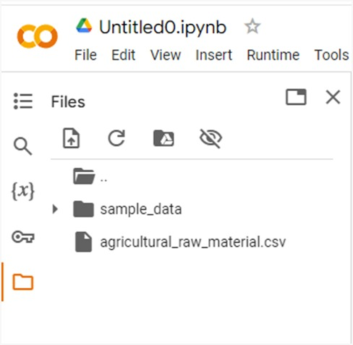
Execution
Importing the Dataset in Google Colab

Slide 13
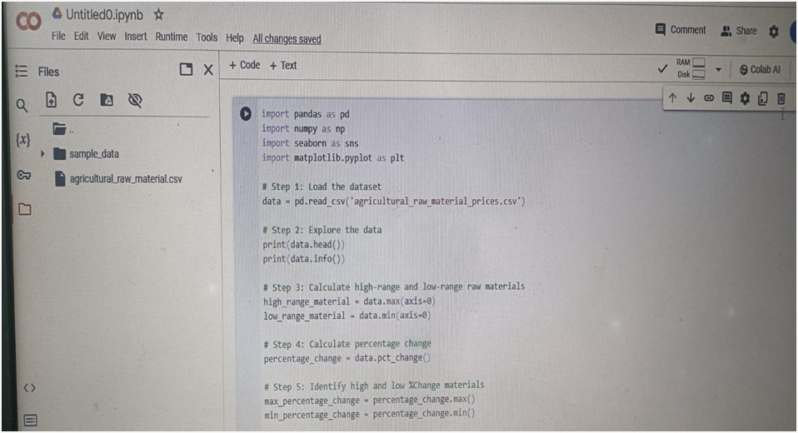
Analyzing agricultural-raw-material-prices dataset:

Slide 14


Slide 15
Future scope
Agricultural Raw Material Analysis includes implementing real-time data analytics for dynamic pricing strategies, integrating IoT and remote sensing technologies for precise yield forecasting, and leveraging blockchain for transparent supply chain management to ensure sustainability and traceability in agricultural production. Additionally, advancements in AI and machine learning can offer predictive models for risk management and adaptive decision-making in response to evolving market conditions and climate change impacts.

Slide 16
Conclusion
The Exploratory Data Analysis (EDA) of Agricultural Raw Material provides valuable insights into pricing dynamics and relationships among commodities, enabling informed decision-making for stakeholders in the agricultural sector. Further analysis and refinement of strategies based on these insights can enhance market competitiveness and sustainability.

Slide 17
References
https://typeset.io/questions/what-is-agricultural-raw-materials-provide-with-citation-and-3ii9drfd1b

